Slide 1
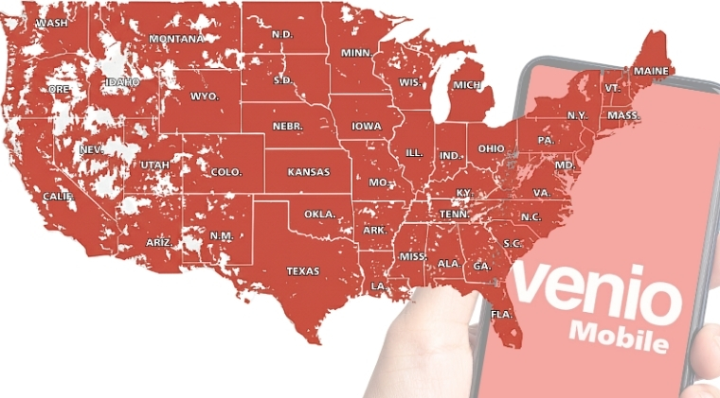

Venio Mobile
USA 5G MVNO with a difference
Connectivity, Communication & International Transfers — Unified
Investment Opportunity
Notes:
Initially providing nano credit lending, Venio pivoted in 2021, expanded into Colombia, Mexico, and the U.S.A and now offers an extended network of financial services across its markets including bill payments, a goods & services marketplace, credit facilities and Venio Credit transfer. Venio provides a one-stop Application for financial services and commerce with serious global scale & ambition.
Initially providing nano credit lending, Venio pivoted in 2021, expanded into Colombia, Mexico, and the U.S.A and now offers an extended network of financial services across its markets including bill payments, a goods & services marketplace, credit facilities and Venio Credit transfer. Venio provides a one-stop Application for financial services and commerce with serious global scale & ambition.

Slide 2

THE OPPORTUNITY
Mobile Is the Center of Cross-Border Life
Millions of people live mobile-first, cross-border lives.
They communicate daily, rely on their mobile phone as their primary connection and regularly support family members in other countries.
Annually $150B flows from the U.S. driven by long-term diaspora communities supporting families across borders. $60B+ is sent to Mexico alone, with major corridors also connecting the U.S. to markets such as the Philippines and Venezuela.
Yet today:
Mobile plans are designed for local usage only
Communication apps operate outside the mobile experience
International transfers live in separate, standalone platforms
This creates friction for users whose lives are inherently global.
As Smartphone adoption continues to grow, the demand is no longer just for connected services
— it is for a unified mobile experience built for cross-border families.
With a massive, recurring, under-served market the opportunity is to own the unified, device-level relationship where communication, connectivity and international value converge.
Notes:
Initially providing nano credit lending, Venio pivoted in 2021, expanded into Colombia, Mexico, and the U.S.A and now offers an extended network of financial services across its markets including bill payments, a goods & services marketplace, credit facilities and Venio Credit transfer. Venio provides a one-stop Application for financial services and commerce with serious global scale & ambition.
Initially providing nano credit lending, Venio pivoted in 2021, expanded into Colombia, Mexico, and the U.S.A and now offers an extended network of financial services across its markets including bill payments, a goods & services marketplace, credit facilities and Venio Credit transfer. Venio provides a one-stop Application for financial services and commerce with serious global scale & ambition.

Slide 3
THE HIDDEN INSIGHT
Mobile Is the Constant in Cross-Border Life
For global families cross-border interaction is daily not occasional.
The phone is already the hub of cross-border life — but the experience around it is fragmented.
The real insight is simple:
If communication lives on the phone,
Value should move there too.
Venio delivers value and lifestyle impact with how people already communicate and stay connected.
They talk every day
They support family members regularly
They rely on their phone for everything
A mobile plan for connectivity
A platform for international transfer
An app for communication
Yet the services they depend on are designed for isolated moments:
Notes:
Initially providing nano credit lending, Venio pivoted in 2021, expanded into Colombia, Mexico, and the U.S.A and now offers an extended network of financial services across its markets including bill payments, a goods & services marketplace, credit facilities and Venio Credit transfer. Venio provides a one-stop Application for financial services and commerce with serious global scale & ambition.
Initially providing nano credit lending, Venio pivoted in 2021, expanded into Colombia, Mexico, and the U.S.A and now offers an extended network of financial services across its markets including bill payments, a goods & services marketplace, credit facilities and Venio Credit transfer. Venio provides a one-stop Application for financial services and commerce with serious global scale & ambition.

Slide 4


THE PROBLEM
Cross-border families rely on their mobile phone every day. Yet mobile service, communication and international transfers live in separate platforms.
Users are forced to switch apps, restart processes and rebuild trust each time. This fragmentation creates friction, inefficiency, and broken experiences.
Engagement stays low and value flows are interrupted
Cross-border life demands a unified, mobile-first solution.
The issue is not communication.
The issue is that no system is built to capture and serve the full cross-border relationship.
What exists today are tools.
What is missing is a connected network layer.
Venio provides the solution
Notes:
Initially providing nano credit lending, Venio pivoted in 2021, expanded into Colombia, Mexico, and the U.S.A and now offers an extended network of financial services across its markets including bill payments, a goods & services marketplace, credit facilities and Venio Credit transfer. Venio provides a one-stop Application for financial services and commerce with serious global scale & ambition.
Initially providing nano credit lending, Venio pivoted in 2021, expanded into Colombia, Mexico, and the U.S.A and now offers an extended network of financial services across its markets including bill payments, a goods & services marketplace, credit facilities and Venio Credit transfer. Venio provides a one-stop Application for financial services and commerce with serious global scale & ambition.

Slide 5





THE SOLUTION
Venio Mobile replaces fragmented tools with a single integrated network layer designed for cross-border communities.
Instead of forcing users to navigate disconnected platforms, Venio unifies:
All within one trusted environment.
By connecting these elements at the network level, Venio allows value to move as naturally as conversation.
This unified layer:
Eliminates friction between services
Preserves context, trust, and identity
Increases frequency and lifetime value
Enables multiple transactions from one relationship
$ Value transfer
Mobile services
Cash-to-digital access
Venio To Talk (Push To Talk)
Communication
Venio Mobile is not another app in the stack —
it is the infrastructure that connects the stack.
Notes:
Initially providing nano credit lending, Venio pivoted in 2021, expanded into Colombia, Mexico, and the U.S.A and now offers an extended network of financial services across its markets including bill payments, a goods & services marketplace, credit facilities and Venio Credit transfer. Venio provides a one-stop Application for financial services and commerce with serious global scale & ambition.
Initially providing nano credit lending, Venio pivoted in 2021, expanded into Colombia, Mexico, and the U.S.A and now offers an extended network of financial services across its markets including bill payments, a goods & services marketplace, credit facilities and Venio Credit transfer. Venio provides a one-stop Application for financial services and commerce with serious global scale & ambition.

Slide 6


WHAT IS VENIO MOBILE?
Venio Mobile is a mobile-first ecosystem built for cross-border communities.
It combines connectivity, communication, and international transfers in one experience.
Venio Mobile acts as the entry point into the Venio Ecosystem.
It anchors users through recurring mobile usage.
Venio To Talk (Push To Talk) drives daily communication and trust.
International transfers are embedded where relationships already exist.
Venio Mobile is not just a plan — it is the mobile layer of a cross-border network.
Notes:
Initially providing nano credit lending, Venio pivoted in 2021, expanded into Colombia, Mexico, and the U.S.A and now offers an extended network of financial services across its markets including bill payments, a goods & services marketplace, credit facilities and Venio Credit transfer. Venio provides a one-stop Application for financial services and commerce with serious global scale & ambition.
Initially providing nano credit lending, Venio pivoted in 2021, expanded into Colombia, Mexico, and the U.S.A and now offers an extended network of financial services across its markets including bill payments, a goods & services marketplace, credit facilities and Venio Credit transfer. Venio provides a one-stop Application for financial services and commerce with serious global scale & ambition.

Slide 7
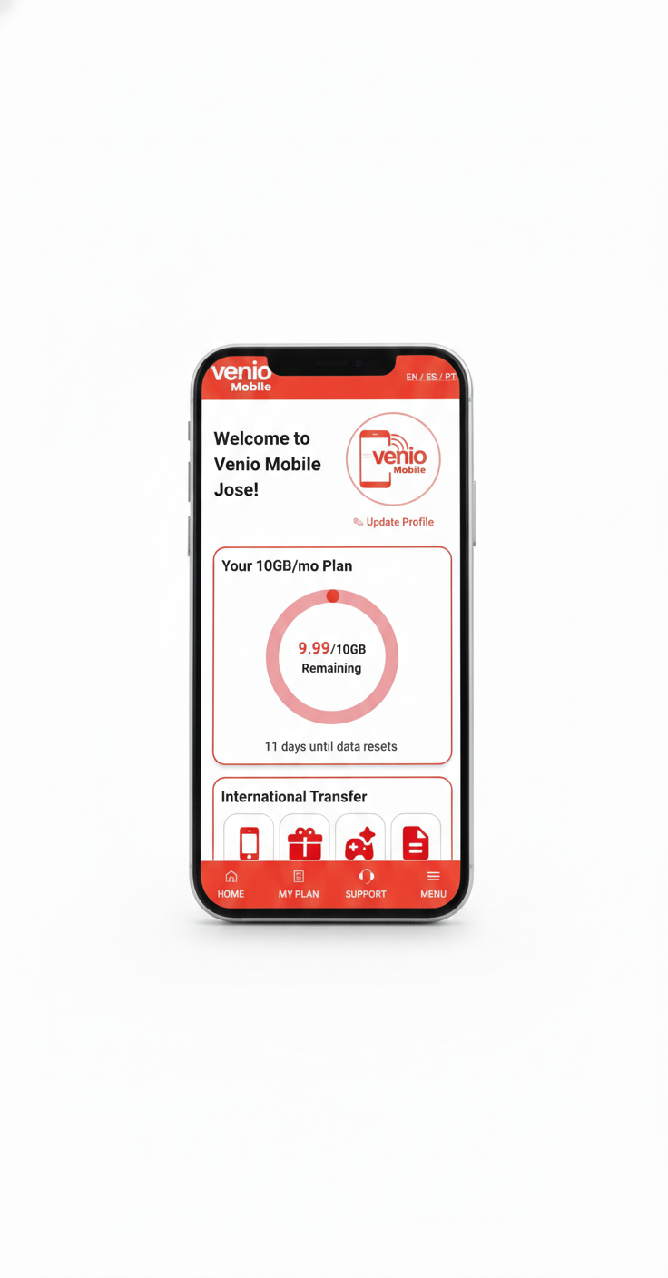
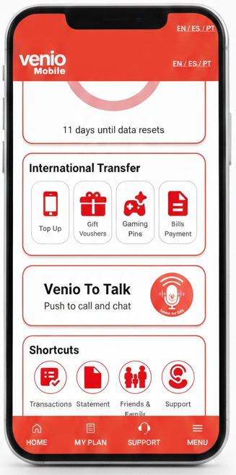
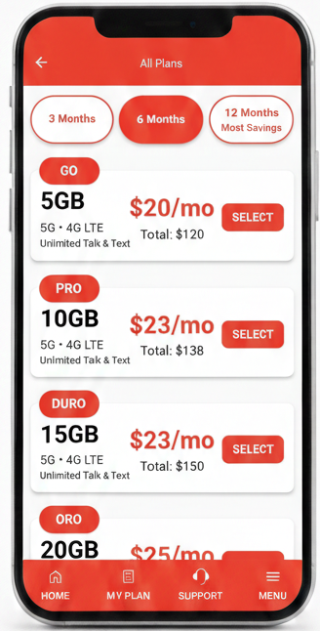

VENIO MOBILE APP
A clean, modern and intuitive mobile experience designed around simplicity and cross-border connectivity. Users can easily manage their data plans, monitor usage in real time, access International Transfers and use Venio To Talk (Push-to-Talk).
All within a seamless unified interface built for global families.
Notes:
Initially providing nano credit lending, Venio pivoted in 2021, expanded into Colombia, Mexico, and the U.S.A and now offers an extended network of financial services across its markets including bill payments, a goods & services marketplace, credit facilities and Venio Credit transfer. Venio provides a one-stop Application for financial services and commerce with serious global scale & ambition.
Initially providing nano credit lending, Venio pivoted in 2021, expanded into Colombia, Mexico, and the U.S.A and now offers an extended network of financial services across its markets including bill payments, a goods & services marketplace, credit facilities and Venio Credit transfer. Venio provides a one-stop Application for financial services and commerce with serious global scale & ambition.

Slide 8







WHAT’S INSIDE VENIO MOBILE
Mobile Voice, Text & Data Plans
Low Cost Voice, Text, and Data plans with reliable international calling
International Transfers
Move money across borders with confidence. From supporting family back home to paying international bills. Access food, groceries, transportation – all top brands
Real-Time Usage & Data Management
Transparent control of plans, real-time usage tracking, and seamless plan management directly from the app.
Bill Payments & Essential Services
Pay utility bills, phone bills, and other essential services abroad quickly and securely.
Venio To Talk (Push To Talk)
Communication service integrated into the Venio Mobile app, allowing users to talk in real time with the press of a button—eliminating the hassle of long-distance dialing codes or the delays of typing long messages.
Unified Cross-Border Mobile Experience
A single platform combining connectivity, communication, transfers, and marketplace services into one seamless mobile experience.
Venio Mobile “Your World Connected”
Notes:
Initially providing nano credit lending, Venio pivoted in 2021, expanded into Colombia, Mexico, and the U.S.A and now offers an extended network of financial services across its markets including bill payments, a goods & services marketplace, credit facilities and Venio Credit transfer. Venio provides a one-stop Application for financial services and commerce with serious global scale & ambition.
Initially providing nano credit lending, Venio pivoted in 2021, expanded into Colombia, Mexico, and the U.S.A and now offers an extended network of financial services across its markets including bill payments, a goods & services marketplace, credit facilities and Venio Credit transfer. Venio provides a one-stop Application for financial services and commerce with serious global scale & ambition.

Slide 9
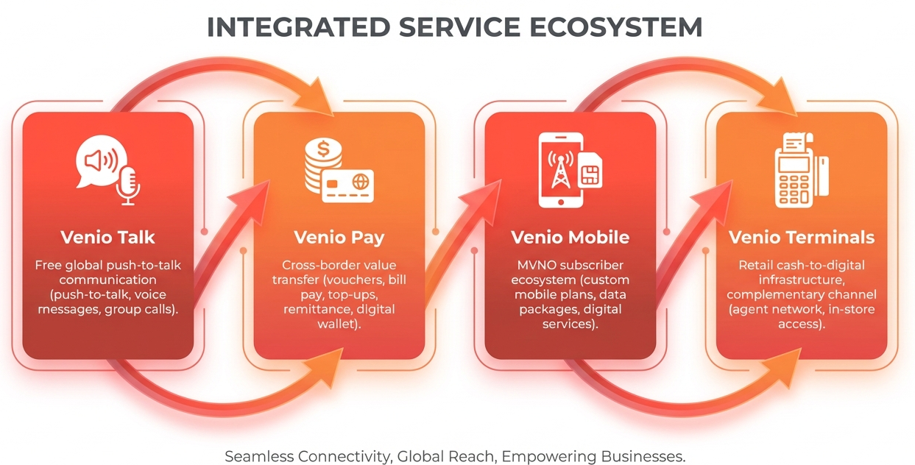
VENIO ECOSYSTEM
Venio is designed as an ecosystem, where each product strengthens the other and increases overall network value.
Rather than operating as standalone services, Venio’s modules are interconnected, allowing users to communicate, transact, and access services within the same trusted environment.
The Ecosystem Effect:
Each layer reinforces the others
Talk drives trust and engagement
Pay captures transaction flow
Mobile locks in recurring usage
Terminals expand accessibility
Together they form a self-reinforcing cross-border network.
Venio does not compete feature by feature.
It competes by owning the relationship layer.
Notes:
Initially providing nano credit lending, Venio pivoted in 2021, expanded into Colombia, Mexico, and the U.S.A and now offers an extended network of financial services across its markets including bill payments, a goods & services marketplace, credit facilities and Venio Credit transfer. Venio provides a one-stop Application for financial services and commerce with serious global scale & ambition.
Initially providing nano credit lending, Venio pivoted in 2021, expanded into Colombia, Mexico, and the U.S.A and now offers an extended network of financial services across its markets including bill payments, a goods & services marketplace, credit facilities and Venio Credit transfer. Venio provides a one-stop Application for financial services and commerce with serious global scale & ambition.

Slide 10
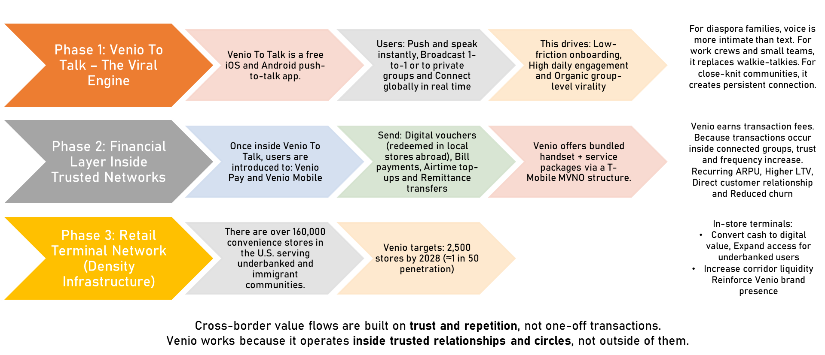
HOW VENIO MAKES MONEY
Notes:
Initially providing nano credit lending, Venio pivoted in 2021, expanded into Colombia, Mexico, and the U.S.A and now offers an extended network of financial services across its markets including bill payments, a goods & services marketplace, credit facilities and Venio Credit transfer. Venio provides a one-stop Application for financial services and commerce with serious global scale & ambition.
Initially providing nano credit lending, Venio pivoted in 2021, expanded into Colombia, Mexico, and the U.S.A and now offers an extended network of financial services across its markets including bill payments, a goods & services marketplace, credit facilities and Venio Credit transfer. Venio provides a one-stop Application for financial services and commerce with serious global scale & ambition.

Slide 11
BUSINESS MODEL
Ecosystem Upside
Subscription & Connectivity Revenue
Monetizing the Network, Not the Transaction
Transaction-Based Revenue
A Scalable Model
Retail & Infrastructure Revenue
Venio generates revenue from cross-border value flows through Venio Pay, including:
Remittances
Bill payments
Vouchers
Mobile top-ups
Fees are embedded naturally within high-frequency usage, reducing price sensitivity.
Venio scales by:
Increasing transactions per user
Expanding services per relationship
Growing across new corridors
Venio does not need to replace users repeatedly.
It grows by monetizing the same and new relationships more deeply over time.
As usage deepens, Venio unlocks additional monetization opportunities:
Cross-selling services within the network
Partner integrations offering new products
Data-driven service optimization using AI
Subscription & Connectivity Revenue
Through Venio Mobile (MVNO), Venio benefits from:
Recurring subscriber revenue
Predictable monthly cash flows
Higher user lock-in and retention
Connectivity becomes both a product and a distribution engine.
Venio Terminals enable:
Cash-to-digital onboarding
Retail-based transactions
Potential B2B and partner service fees
This channel expands reach while generating offline-to-online conversion value.
Notes:
Initially providing nano credit lending, Venio pivoted in 2021, expanded into Colombia, Mexico, and the U.S.A and now offers an extended network of financial services across its markets including bill payments, a goods & services marketplace, credit facilities and Venio Credit transfer. Venio provides a one-stop Application for financial services and commerce with serious global scale & ambition.
Initially providing nano credit lending, Venio pivoted in 2021, expanded into Colombia, Mexico, and the U.S.A and now offers an extended network of financial services across its markets including bill payments, a goods & services marketplace, credit facilities and Venio Credit transfer. Venio provides a one-stop Application for financial services and commerce with serious global scale & ambition.

Slide 12
STRATEGIC ADVANTAGES
Communication-Led Acquisition
Most remittance companies buy customers.
Venio builds communities through daily communication.
Venio To Talk becomes the primary entry point, dramatically reducing acquisition costs and increasing trust.
Network Effects at the Family Level
Venio grows through family and social clusters, not isolated users.
As more members of a cross-border network join:
Communication frequency increases
Transactions become natural and recurring
Overall network value compounds
Diversified Monetization
Venio monetizes the relationship across multiple layers:
Transaction fees (Venio Pay)
MVNO ARPU (Venio Mobile)
Venio To Talk fees
Handset margin
Future cross-border retail expansion
This reduces dependency on any single revenue stream.
High LTV Potential
Daily communication creates stronger retention than occasional remittance usage.
Venio captures value over time, not per event.
Global Corridor Expansion
The model is repeatable across corridors, with future rollout planned:
Venio To Talk in: Mexico, Colombia, UAE and Philippines.
MVNO - Planned Launched in Mexico and Colombia
Venio scales horizontally across geographies using the same network logic.
Built to Scale Through Networks
Venio is strategically positioned to scale through community-driven adoption, not transaction-based acquisition.
Most cross-border platforms grow corridor by corridor.
Venio grows network by network.
Notes:
Initially providing nano credit lending, Venio pivoted in 2021, expanded into Colombia, Mexico, and the U.S.A and now offers an extended network of financial services across its markets including bill payments, a goods & services marketplace, credit facilities and Venio Credit transfer. Venio provides a one-stop Application for financial services and commerce with serious global scale & ambition.
Initially providing nano credit lending, Venio pivoted in 2021, expanded into Colombia, Mexico, and the U.S.A and now offers an extended network of financial services across its markets including bill payments, a goods & services marketplace, credit facilities and Venio Credit transfer. Venio provides a one-stop Application for financial services and commerce with serious global scale & ambition.

Slide 13





ROLLOUT STRATEGY
Raise – US$250,000 – Own 10% of Venio
Focused Entry, Scalable Execution
Venio’s rollout strategy prioritizes high-volume corridors and dense diaspora markets to accelerate network effects.
$250K at $2.5M pre-money
Use of Funds
Deployment of 50 pilot retail locations
User acquisition for Venio To Talk
Compliance & infrastructure
Sales and installations team
Initial Corridor Focus:
USA → Mexico
USA → Philippines
USA → Venezuela
USA → Central America
Launch Markets:
Atlanta, Los Angeles, Houston, Dallas and Chicago
These cities combine:
Large diaspora populations
High remittance volume
Strong retail density
Milestones
50 stores Q2 2026
500 stores end 2026
2,500 stores by 2028
Parallel growth of Venio To Talk user base
Future MVNO
Mexico
Colombia
Notes:
Initially providing nano credit lending, Venio pivoted in 2021, expanded into Colombia, Mexico, and the U.S.A and now offers an extended network of financial services across its markets including bill payments, a goods & services marketplace, credit facilities and Venio Credit transfer. Venio provides a one-stop Application for financial services and commerce with serious global scale & ambition.
Initially providing nano credit lending, Venio pivoted in 2021, expanded into Colombia, Mexico, and the U.S.A and now offers an extended network of financial services across its markets including bill payments, a goods & services marketplace, credit facilities and Venio Credit transfer. Venio provides a one-stop Application for financial services and commerce with serious global scale & ambition.

Slide 14
WHY INVEST NOW
Mobile penetration is universal
MVNO models are mature and scalable
International transfer rails are established
Retail cash networks can be digitized
Viral Communication Tools & Apps: Leverage established WhatsApp type services with Venio To Talk (Push-to-Talk App) using AI as a differentiation.
👉 What was complex five years ago is now deployable at scale.
Global families communicate daily, not occasionally.
The mobile phone is their primary connection to the world.
Venio Mobile aligns connectivity, communication, and international value inside one mobile-first ecosystem.
Massive, persistent diaspora demand
Communication-first differentiates vs legacy remittance apps
Exclusive Communication Technology -
Venio To Talk (Push-to-Talk)
Clean cap table
Early valuation entry point
Multiple strategic exit paths (MNOs, MVNOs, fintech platforms, payment networks)
Mobile Is the Center of Cross-Border Life
The Mobile Ecosystem Is Finally Ready
Remittance Is Moving Inside Mobile Experiences
Early Ecosystem Ownership Creates Defensibility
Scenario projection: $9.5M EBITDA by 2028
15x multiple → $142M valuation potential
The market is shifting from:
Price-driven transactions
to
Embedded, high-frequency value inside mobile usage
Venio Mobile is positioned ahead of this shift, not reacting to it.
  The earlier Venio Mobile captures communication-led user networks:
  The harder it becomes to displace
  The higher the lifetime value
  The stronger the ecosystem lock-in
  This is a land-grab for the mobile relationship layer.
Notes:
Initially providing nano credit lending, Venio pivoted in 2021, expanded into Colombia, Mexico, and the U.S.A and now offers an extended network of financial services across its markets including bill payments, a goods & services marketplace, credit facilities and Venio Credit transfer. Venio provides a one-stop Application for financial services and commerce with serious global scale & ambition.
Initially providing nano credit lending, Venio pivoted in 2021, expanded into Colombia, Mexico, and the U.S.A and now offers an extended network of financial services across its markets including bill payments, a goods & services marketplace, credit facilities and Venio Credit transfer. Venio provides a one-stop Application for financial services and commerce with serious global scale & ambition.

Slide 15

VISION
Venio Mobile — The Mobile Infrastructure for Cross-Border Families
Venio Mobile powers interconnected global families, enabling them to stay connected, communicate instantly, and move value seamlessly across borders — all through their mobile device.
As migration and global mobility increase, cross-border relationships are no longer occasional.
They are continuous and mobile-first.
Yet the mobile services that support them remain fragmented.
Previously inaccessible markets: dramatic shift in politically challenged regions like Venezuela, creating new global inclusion opportunities.
Venio Mobile is changing that.
We are not building a traditional mobile plan.
We are building the mobile ecosystem for cross-border human networks.
By unifying connectivity, communication, and international transfers, Venio Mobile enables families and communities to operate across borders as if distance did not exist.
Over time, Venio Mobile evolves from an MVNO into foundational mobile infrastructure — supporting not just communication and money movement, but participation, services, and opportunity at global scale.
Venio Mobile — Cross-Border Life, Connected.
Notes:
Initially providing nano credit lending, Venio pivoted in 2021, expanded into Colombia, Mexico, and the U.S.A and now offers an extended network of financial services across its markets including bill payments, a goods & services marketplace, credit facilities and Venio Credit transfer. Venio provides a one-stop Application for financial services and commerce with serious global scale & ambition.
Initially providing nano credit lending, Venio pivoted in 2021, expanded into Colombia, Mexico, and the U.S.A and now offers an extended network of financial services across its markets including bill payments, a goods & services marketplace, credit facilities and Venio Credit transfer. Venio provides a one-stop Application for financial services and commerce with serious global scale & ambition.

Slide 16
MEET OUR TEAM
Notes:
Initially providing nano credit lending, Venio pivoted in 2021, expanded into Colombia, Mexico, and the U.S.A and now offers an extended network of financial services across its markets including bill payments, a goods & services marketplace, credit facilities and Venio Credit transfer. Venio provides a one-stop Application for financial services and commerce with serious global scale & ambition.
Initially providing nano credit lending, Venio pivoted in 2021, expanded into Colombia, Mexico, and the U.S.A and now offers an extended network of financial services across its markets including bill payments, a goods & services marketplace, credit facilities and Venio Credit transfer. Venio provides a one-stop Application for financial services and commerce with serious global scale & ambition.

Slide 17




Warren Platt is an accomplished telecoms technology entrepreneur and executive with global experience. He founded Venio with the aim to address a void in access to basic financial assistance in emerging markets. Specializing in international business development, marketing, strategic planning, relationship development, contract negotiation and P&L management. He has a deep knowledge of mobile technologies, digital media and marketing as well as billing pre-paid mobile subscriber bases.
Warren Platt
Founder & CEO
Lariza Arcilla is an experienced senior software engineer and technical director who has worked with multiple startups. She has successful background in leading collaborative teams and implementing quality products. She also has experience working with clients in the banking industry. Her areas of expertise include creating core backends with API integrations, REST API development, and web and mobile development.
Jelena Tomic is an accomplished Financial Director with excellent management / technical skills combining a practical approach to accounting and reporting. Jelena is a strong communicator capable of contributing effectively and using her own initiative when working as a team member as well as on her own. A strong Finance professional who enjoys working in challenging environments. Area of expertise include P&L Management, Forex, Tax, M&A, Audit, Forecasting / Cashflow Management.
Anne Balmoria is an experienced Digital Marketing professional and Product Manager with a decade of experience working with different industries such a FMCG, Tech, E-commerce/Retail, Academia and Fintech for both local and international markets. Her expertise includes Media Planning, Affiliate Marketing, Performance Marketing using multiple platforms and Project Management.
Lariza Arcilla
CTO
Jelena Tomic
Finance Director
Anne Balmoria
Marketing Director
Notes:
Initially providing nano credit lending, Venio pivoted in 2021, expanded into Colombia, Mexico, and the U.S.A and now offers an extended network of financial services across its markets including bill payments, a goods & services marketplace, credit facilities and Venio Credit transfer. Venio provides a one-stop Application for financial services and commerce with serious global scale & ambition.
Initially providing nano credit lending, Venio pivoted in 2021, expanded into Colombia, Mexico, and the U.S.A and now offers an extended network of financial services across its markets including bill payments, a goods & services marketplace, credit facilities and Venio Credit transfer. Venio provides a one-stop Application for financial services and commerce with serious global scale & ambition.

Slide 18



Angie Garcia has experience providing customer and end user service support and is capable of designing, analyzing, managing and optimizing production and logistics systems to support business. She possesses great versatility across multiple areas of operations to achieve objectives.
Mico is a software engineer who has worked on creating various products including banking applications. He is capable of doing REST API, API integrations, web and mobile development using multiple programming languages.
Satwinder Sran is an experienced Commercial Manager with a demonstrated history of working in the telecommunications industry. Skilled in Sales, Business Development Marketing Strategy, Management, and Business Strategy. A strong sales professional dedicated to providing customer focused value and strong relationship management.
Mico Chang
Senior Software Engineer
Satwinder Sran
Commercial Director
Angie Garcia
Director of Global Operations
Notes:
Initially providing nano credit lending, Venio pivoted in 2021, expanded into Colombia, Mexico, and the U.S.A and now offers an extended network of financial services across its markets including bill payments, a goods & services marketplace, credit facilities and Venio Credit transfer. Venio provides a one-stop Application for financial services and commerce with serious global scale & ambition.
Initially providing nano credit lending, Venio pivoted in 2021, expanded into Colombia, Mexico, and the U.S.A and now offers an extended network of financial services across its markets including bill payments, a goods & services marketplace, credit facilities and Venio Credit transfer. Venio provides a one-stop Application for financial services and commerce with serious global scale & ambition.

Slide 19




+1 404-663-5003
support@venio.com
www.veniomobile.com
Interested in investing in a transformational opportunity?
Confidential Information and Proprietary.
This presentation is the property of Venio US Inc.
Venio US Inc. reserves all rights in such submission. Accordingly, the receiving party agrees to protect the confidentiality of all information contained herein, except as may be required by any applicable law, governmental order, or applicable regulation, or by order or decree of any court of competent jurisdiction.
The receiving party shall not, without the prior written consent of Venio US Inc., publicly disclose, advertise, or in any way disclose to any unrelated third party, any information or matters disclosed herein, and each party shall do all things that are reasonably necessary to prevent such information not being known to any party other than the parties to this submission.
Get in touch with us!
Notes:
Initially providing nano credit lending, Venio pivoted in 2021, expanded into Colombia, Mexico, and the U.S.A and now offers an extended network of financial services across its markets including bill payments, a goods & services marketplace, credit facilities and Venio Credit transfer. Venio provides a one-stop Application for financial services and commerce with serious global scale & ambition.
Initially providing nano credit lending, Venio pivoted in 2021, expanded into Colombia, Mexico, and the U.S.A and now offers an extended network of financial services across its markets including bill payments, a goods & services marketplace, credit facilities and Venio Credit transfer. Venio provides a one-stop Application for financial services and commerce with serious global scale & ambition.

